Slide 1
Probabilistic models for Pronunciation and Spelling

Slide 2
Probabilistic models for Pronunciation and Spelling
In this Topic discusses the Problem of detecting and Correcting spelling errors.
First introduce the problems of detecting and Correcting spelling errors; also summarize typical human spelling error patterns
Introduce ways to solve the spelling problem : Bayes Rule and the noisy channel model.

Slide 3
Probabilistic models for Pronunciation and Spelling
Dealing with spelling errors.
Spelling error patterns.
Detecting non word errors.
Probabilistic model.
Applying the Bayesian method to spelling
Minimum edit distance

Slide 4
Dealing with spelling errors
Classification of Spelling correction.
Non word error detection : Detecting spelling errors that result in non-words.
Isolated-word error correction : Correcting spelling errors that result in non words.(correcting graffe to giraffe, but looking only at the word in isolation. )
Context dependent error detection and correction : using the context to help detect and correct real word errors.(dessert for desert or there for their)

Slide 5
Dealing with spelling errors
Application area
Typed Text (Word Processor)
Optical character recognition – OCR (Optical scanner)
Online handwritten recognition

Slide 6
Spelling errors patterns
The number and nature of spelling errors in human typed text differs from those caused by pattern recognition devices like OCR and handwriting recognizers.
-Number
1-3 % in human typed text.
Vary 0.2 -20% for OCR .
-Nature.

Slide 7
Nature of Spelling errors
Human typing errors
-Insertion : the as ther
-Deletion : the as th
Substitution : the as thw
Transposition : the as the

Slide 8
Nature of Spelling errors
Other dimension of classification
Typographic errors : keyboard related. Spell as spwll
Cognitive errors : the writer doesn’t know how to spell. Separate as separate.

Slide 9
Nature of spelling errors
OCR errors.
-Substitution
Multi substitution
Space deletion
Insertion
Failure

Slide 10
An example for OCR errors
Correct : The quick brown fox jumps over the lazy dog.
Recognized : ’lhe q~ick brown foxjurnps ovcr tb lazy dog.
Errors : Substitution (e->c) and multisubstitutions (T-> ‘l, m -> rn, he -> b) are caused by visual similarity rather than keyboard distance; failure(u-> ~) are cases where OCR does not select any letter with sufficient accuracy.

Slide 11
Detecting non-word errors
Detecting non-word errors in text, whether typed by humans ro scanned, is commonly done by using dictionary.
Small or big dictionary ?
-small : Large dictionary contains rare words that resemble misspelling of other words : wont as won’t
-Large : Emperical study found large dictionary are more helpful than harmful.
Use model of morphology for to deal with inflection.

Slide 12
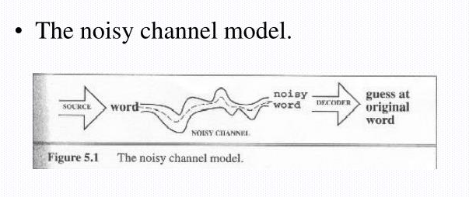
Probabilistic Model

Slide 13
Applying Bayesian Method
Bayesian algorithm
-proposing candidate correlation
-Scoring the candidate
Proposing the candidate
-Simplifying assumption: single spelling errors
-Example misspelling acress

Slide 14
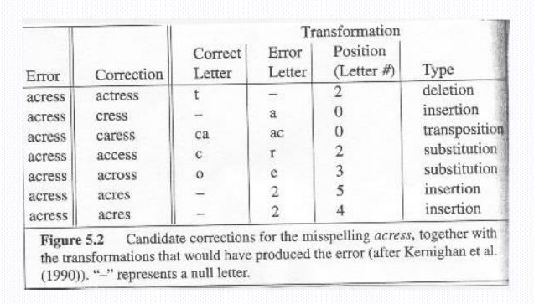
Example

Slide 15
Minimum edit distance
Previous section relied on the simplifying assumption- single spelling error.
We need to more powerful algorithm to handle multiple errors.
Minimum edit distance Algorithms
-String distance , is some metric of how alike two strings are to each other.
-The minimum edit distance between two string is the minimum number of editing operation.

Slide 16
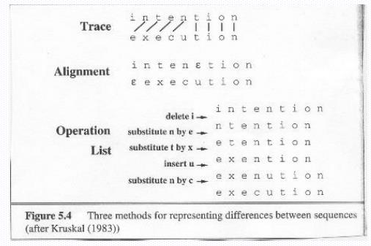
Three method of Representing errors.

